Slide 1
Airline Transit Data
Most Reliable and Unreliable Airlines
Casey Au
Reuben Orihuela
Waylon Jones
Notes:
In your slides fine to keep project goal, dataset information etc. as you presented during the progress report but don't need to repeat during the final presentation unless there's updates.
For most teams focus on your MapReduce programs, implementation/execution steps, and analysis results.

Slide 2
Overview

Slide 3
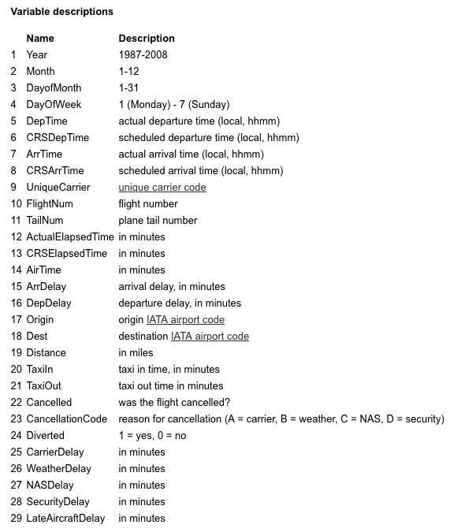
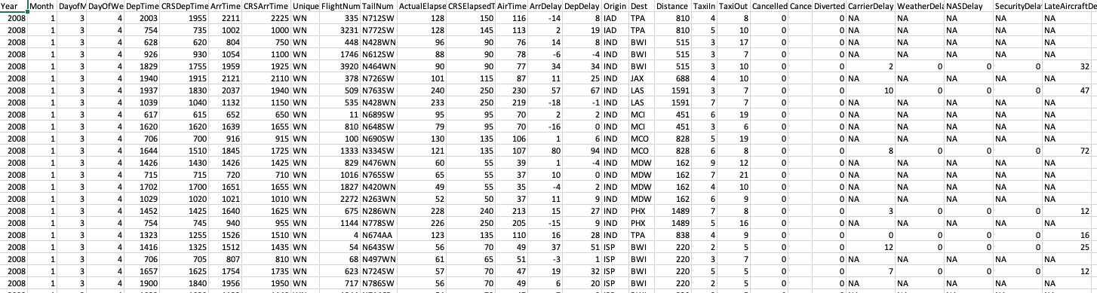
Overview
Goal
Examining flight data from the past collected from airports across the entire US
Look for correlations within the data related.
Find airlines with
least delays
smallest cancellations
Data
600 MB CSV from 2008
American Statistical Association
20 Airlines analyzed
Notes:
(previous text) The goal of our project is to examine previous flight data collected from Airports across the US and determine optimal fight times and airlines door specific destinations.
-each row corresponds to 1 flight;
MOST RELIABLE
Airlines range from having 8000 - 1,000,000 total flights

Slide 4
Program

Slide 5



MapReduce Program

Slide 6
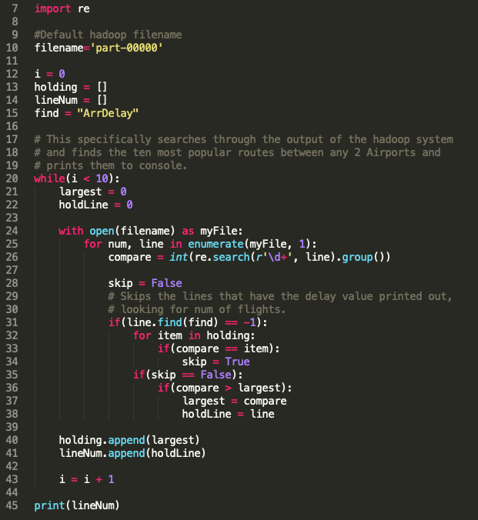
Python Scripts to Filter Data

Slide 7
Results
Notes:
Data gave a bunch of flights for different airlines, so averaged flight delays of each airline, and then compared them
Average =

Slide 8
Program Stats
Advanced Details:
Total time spent by all maps in occupied slots (ms)=42977808
Total time spent by all reduces in occupied slots (ms)=6356930
Total time spent by all map tasks (ms)=273744
Total time spent by all reduce tasks (ms)=40490
Total vcore-milliseconds taken by all map tasks=273744
Total vcore-milliseconds taken by all reduce tasks=40490
Total megabyte-milliseconds taken by all map tasks=1372004928
Total megabyte-milliseconds taken by all reduce tasks=202935880
Basic Details:
GC time elapsed (ms)=5577 or 5.577 seconds
CPU time spent (ms)=180160 or 180.160 seconds

Slide 9
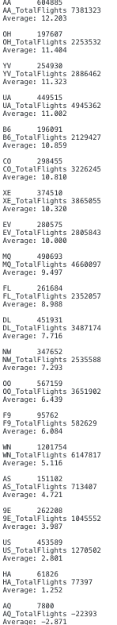
Average Depart Delay
Top 3 Best Airlines (least minutes delayed):
AQ - Aloha Airlines Inc. (-1.390 min)
HA - Hawaiian Airlines Inc. (0.454 min)
US - US Airways Inc. (5.901 min)
Top 3 Worst Airlines (most minutes delayed)
UA - United Airlines Inc. (13.784 min)
CO - Continental Air Lines Inc. (13.024 min)
AA - American Airlines Inc. (12.9 min)
Notes:
US","US Airways Inc. (Merged with America West 9/05. Reporting for both starting 10/07.)"
Continental - us based airline
Average = (total # of min delayed of each airline) / (total # of flights of each airline)

Slide 10
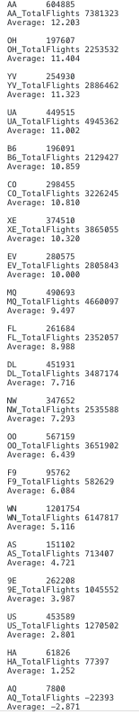
Average Arrival Delay
Top 3 Best Airlines (least minutes delayed):
AQ - Aloha Airlines Inc. (-2.871 min)
HA - Hawaiian Airlines Inc. (1.252 min)
US - US Airways Inc. (2.81 min)
Top 3 Worst Airlines (most minutes delayed)
AA - American Airlines (12.203 min)
OH - Comair Inc. (11.404 min)
YV - Mesa Airlines Inc. (11.323 min)
Notes:
US","US Airways Inc. (Merged with America West 9/05. Reporting for both starting 10/07.)"
Comair inc - based in South africa; scheduled services on domestic routes
Mesa Airlines - american regional airline

Slide 11
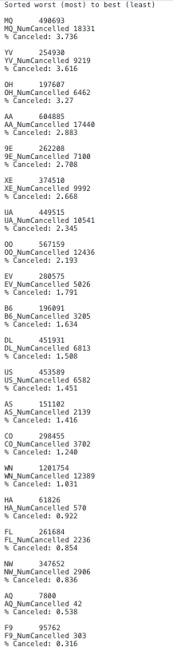
Percent Flights Cancelled
Top 3 best airlines (least amount of flights cancelled):
F9 - Frontier Airlines Inc. (0.316%)
AQ - Aloha Airlines Inc. (0.538%)
NW - Northwest Airlines Inc. (0.836%)
Tow 3 worst airlines (most amount of flights cancelled):
MQ - American Eagle Airlines Inc. (3.736%)
YV - Mesa Airlines Inc. (3.616%)
OH - Comair Inc. (3.27%)
Notes:
Frontier - low cost based in us; has 80 regional dest; 6 international dest
Northwest
lowest
Frontier Airlines Inc. 95,762 flights and 303 cancelled = (0.316%)
AQ - Aloha Airlines Inc. (0.538%) 7800 flights and 42 cancelled
NW - Northwest Airlines Inc. (0.836%) 347,652 flights and 2906 cancelled
FL - AirTran Airways Corporation(0.854%) 261,684 flights and 2,236 cancelled
HA (0.922%) 61,826 flights and 570 cancelled
WN (1.031%) 1,201,754 flights and 12,389 cancelled
Highest
American Eagle Airlines Inc. (3.736%) 490,693 flights and 18,331 cancelled
Mesa Airlines Inc. (3.616%) 254,930 flights and 9,219 cancelled
Comair Inc. (3.27%) 197,607 flights and 6462 cancelled
American Airlines (2.833%) 604,885 flights and 17,440 cancelled
9E (2.708%) 262,208 flights and 7,100 cancelled

Slide 12
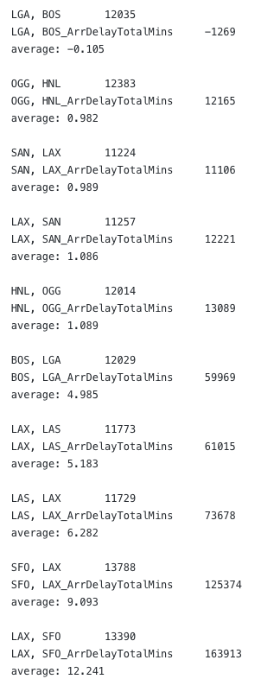
10 Most Popular Routes Sorted by Delay
Top 3 Best Routes (least minutes delayed):
La Guardia, NY -> Boston, MA (-0.105 min)
Kahului, HI -> Honolulu, HI (0.982 min)
San Diego, CA -> Los Angeles, CA (0.989 min)
Top 3 Worst Routes (most minutes delayed)
Los Angeles, CA -> San Francisco, CA (12.241 min)
San Francisco, CA -> Los Angeles, CA (9.093 min)
Las Vegas, NV -> Los Angeles, CA (6.282 min)
Notes:
Popular = most # of flights
Of 10 listed 11,000 - 13,000 flights
best
La Guardia, NY -> Boston, (-0.105 min) 12,035 flights and -1,269 minutes
OGG -> HNL (0.982 min) 12,383 flights and 12,165 minutes
SAN -> LAX (0.989 min)

Slide 13
Demo

Slide 14
Demo!!
Step 1: Prep the file
for Hadoop
hadoop com.sun.tools.javac.Main BookNew.java
jar cf wc.jar BookNew*.class
Step 2: Prepare the
directory in hadoop
hadoop fs -mkdir -p inn
hadoop fs -put $HOME/BigData/Group/input/2008.csv in
Step 3: Run the MapReduce and print results
hadoop jar wc.jar BookNew in/2008.csv output
hadoop fs -get output/*

Slide 15
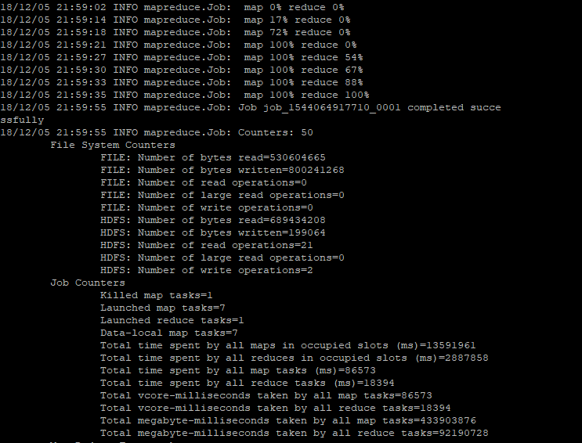
Hadoop Output

Slide 16
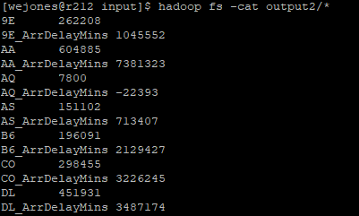
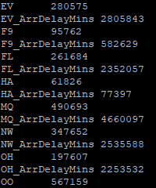
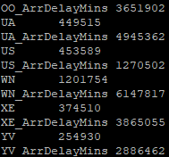
Hadoop Output (cont.)

Slide 17
Questions?

Slide 18
Thank you!

Slide 19
Fin

